Slide 1
A Presentation on-
USED CAR PRICE PREDICTION
By-
Prajakta Waykos
Manasi Patil
Balaji Kamble
Guided By-
Sh. Pappu Dindayal Kapgate

Slide 2
INTRODUCTION
As the automobile industry is booming, the demand for new cars is increasing. With the demand for new cars, used cars have also gained tremendous value.
Estimating the price of these used cars has become crucial by which we can provide the actual value of the car to the buyers and also to the sellers for transparency.
Several method and algorithms may be required in the prediction of a used cars true market worth.

Slide 3
PROBLEM STATEMENT
Used car prices are based on Brand, Manufacturer and Transmission type. This process done by professionals who understand the condition and market demand of cars.
But due to the increase in price of new cars and the inability of customers to buy new cars due to lack of funds and affordability, used car sales are on a global increase.
There is a need for a used car price prediction system to effectively determine the worthiness of the car using a variety of features.

Slide 4
PROJECT SCOPE
This project is not intended to a particular organization.
This project is an attempt to develop generic software, which can be applied by any businesses organization.
This software is going to provide daily reports to legacy systems, which are of greater utility to the business.

Slide 5
PROPOSED SYSTEM
The main aim of this project is to determine the price of used cars using professionals’ evaluation by using various machine Learning Models.
The research has been conducted with several setups to determine the price of used cars by employing the supervised learning model.
Several method and algorithms are be required in the prediction of a used cars true market worth.

Slide 6
SYSTEM OVERVIEW
Models are run using Python Jupyter Notebook.
Dropped the irrelevant column and Null values in dataset.
There were many categorical column in data, so we have done the one hot encoding to all object data type columns.
After running the base model , the parameters are analysed using random search method and best parameters are selected.
The performance of random search model as increased slightly than base model. MSE, Mean Absolute Error as decreased and R^2 has increased when compared to base model.

Slide 7
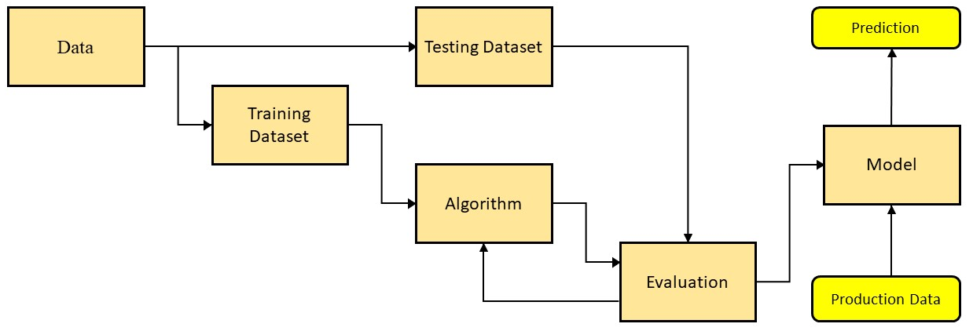
APPLICATION FLOW (ADMIN)

Slide 8
FUTURE SCOPE
The software is made according to the requirement of organization but expansion of modules can be easily included in the software.
Add login with google & facebook.
Enhance user interface
A proper revenue model for the system can be defined.
With slight modifications can be made to work or to fit into any such organization.

Slide 9
CONCLUSION
By performing different ML models, we aim to get a better result or less error with max accuracy. Our purpose was to predict the price of the used cars having 25 predictors and 509577 data entries.
Initially, data cleaning is performed to remove the null values and outliers from the dataset then ML models are implemented to predict the price of cars.
Next, with the help of data visualization features were explored deeply. The relation between the features is examined.
From the below table, it can be concluded that XGBoost is the best model for the prediction for used car prices. XGBoost as a regression model gave the best MSLE and RMSLE values.

Slide 10
THANK YOU

